Slide 1
Lew Cirne
Founder & CEO

Slide 2

Thank you :)
Notes:
TALKING PTS:
how many of you were here in 2009?
Close your eyes, we were a one app rails monitoring company, we got our first customer who paid more than $100k [GET REAL STATS FROM MARK]
5 years goes by fast
Rapid pace of innovation and I’m going to talk about why we’ve been able to do that,

Slide 3
We’ve Come a Long Way…
2020+
Products: 10+
Revenue: $1B+
Paying customers: 50k+
Office square feet: 600k+
10+ offices Employees: 3k+
2015
Products: 7
Revenue: $100M
Paying customers: 11k+
Office square feet: 145k
6 offices Employees: 600+
2010
2009
Products: 1
Revenue: <$1M
Paying customers: <100
Office square feet: <5k
2 offices Employees: 15
Notes:
TALKING PTS:
how many of you were here in 2009?
Close your eyes, we were a one app rails monitoring company, we got our first customer who paid more than $100k [GET REAL STATS FROM MARK]
5 years goes by fast
Rapid pace of innovation and I’m going to talk about why we’ve been able to do that,
TALKING PTS:
While we’ve grown, we’ve changed
We’ve added products, we’ve built a platform
We’ve built a world functions from sales & support, to engineering, to operations
But at the core of this, we’ve stayed true to our Mission and Values which we’ll talk about today
*We build incredible products that our customers love to use*
We have an incredible innovation engine that drives this company forward.
Constant innovation (new products)
We’ve built a brand with the market and the marketplace
That when New Relic delivers a product to market, it will be of high quality
High multiple and amazing brand – high expectations
This is a good problem to have
Values, focus on building great products that customers love

Slide 4

2020+
Products: 10+
Revenue: $1B+
Paying customers: 50k+
Office square feet: 600k+
10+ offices Employees: 3k+
2015
Products: 7
Revenue: $100M
Paying customers: 11k+
Office square feet: 145k
6 offices Employees: 600+
2010
2009
Products: 1
Revenue: <$1M
Paying customers: <100
Office square feet: <5k
2 offices Employees: 15
…While Staying True to our Core
Notes:
…While staying true to our core

Slide 5
Notes:
…While staying true to our core

Slide 6

RESULTS MATTER
We are deeply invested in the success of our customers, the company, and each other. We take pride in what we do and hold ourselves to the highest standards.
WHY DO WE EXIST?

Slide 7
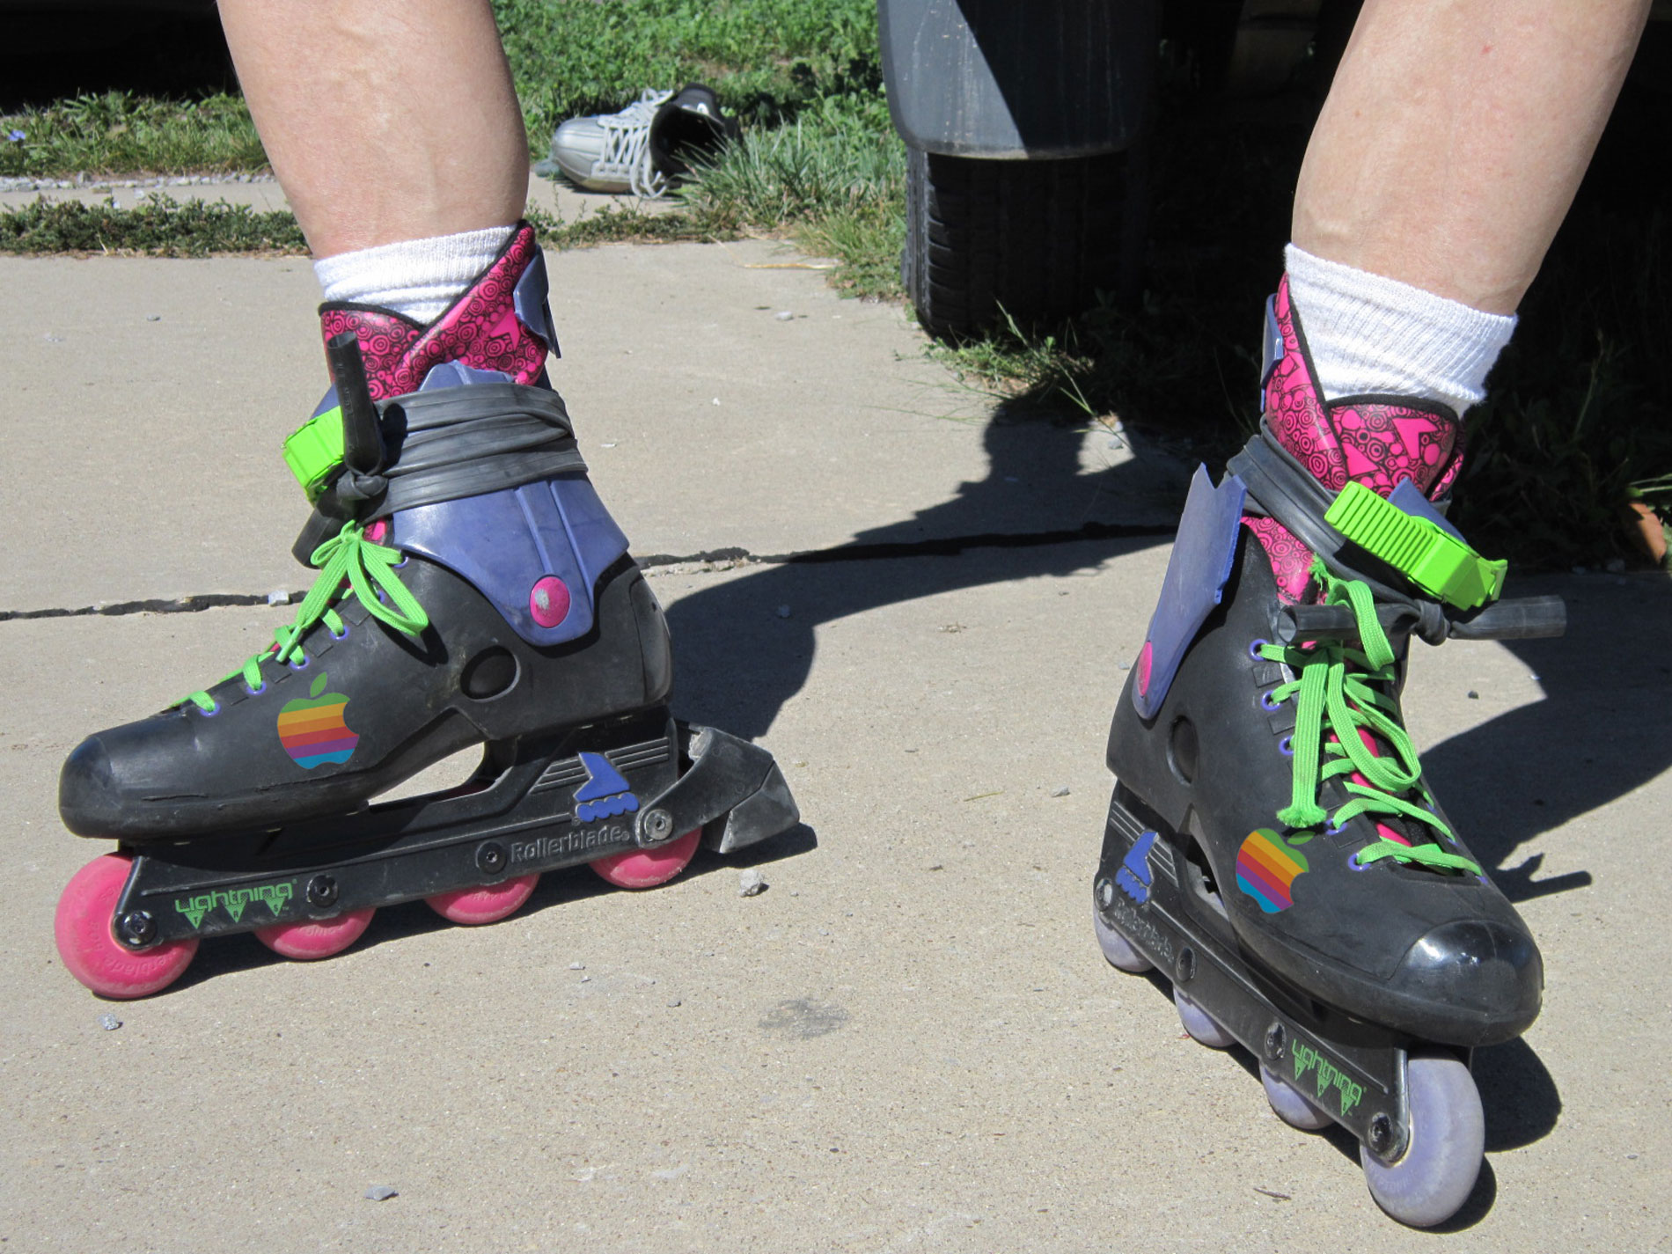

Notes:
But before I go forward, I want to first go back STORY: I want to take you back to 199X when I first moved to Cupertino to work at Apple. I was so excited, I bought a pair of $50 rollerblades and bladed all the way to work.
I was excited to get to create software that others use.
That’s my great joy.
But I had no way of knowing how customers use it.
It was like dropping your kids off to school, but not getting report cards
That seed was beginning of APM market
Everyone needs to be connected
So, I created Wily, and then created NR to reimagine the APM market…

Slide 8
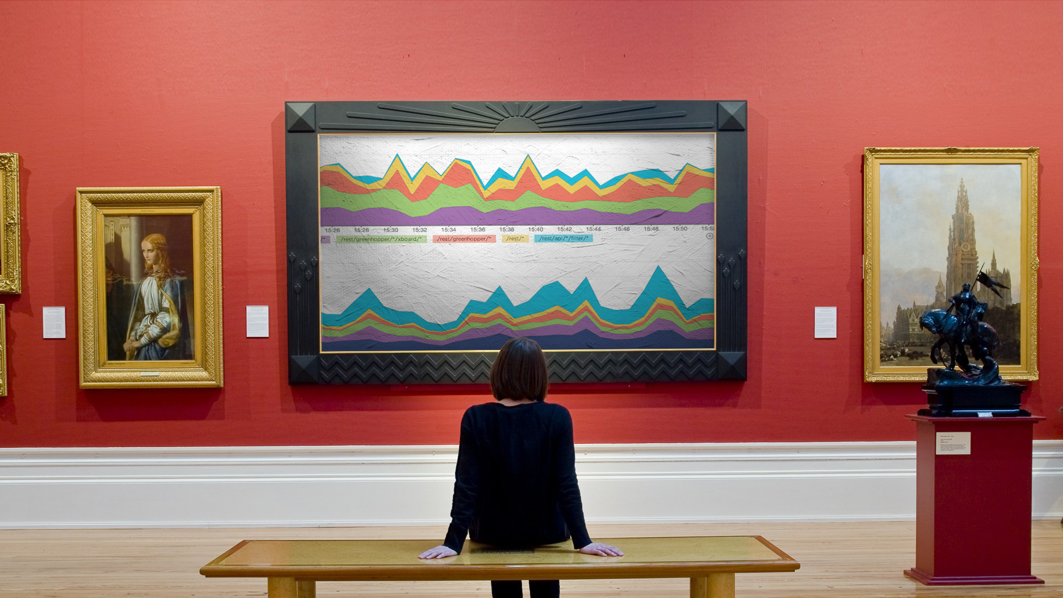

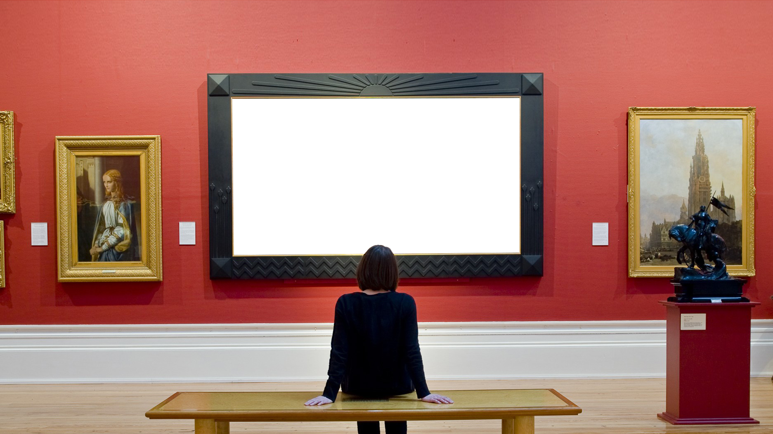

Notes:
TALKING PTS:
Software is the new medium (written word, clay, paint all have constraints)
With SW, the only constraint is the human mind….borders on magic
Things never done before
Power of software – art and science to creating great sw
Just as Gutenberg’s printing press unleashed new innovations in ~1450
There’s an art and a science

Slide 9
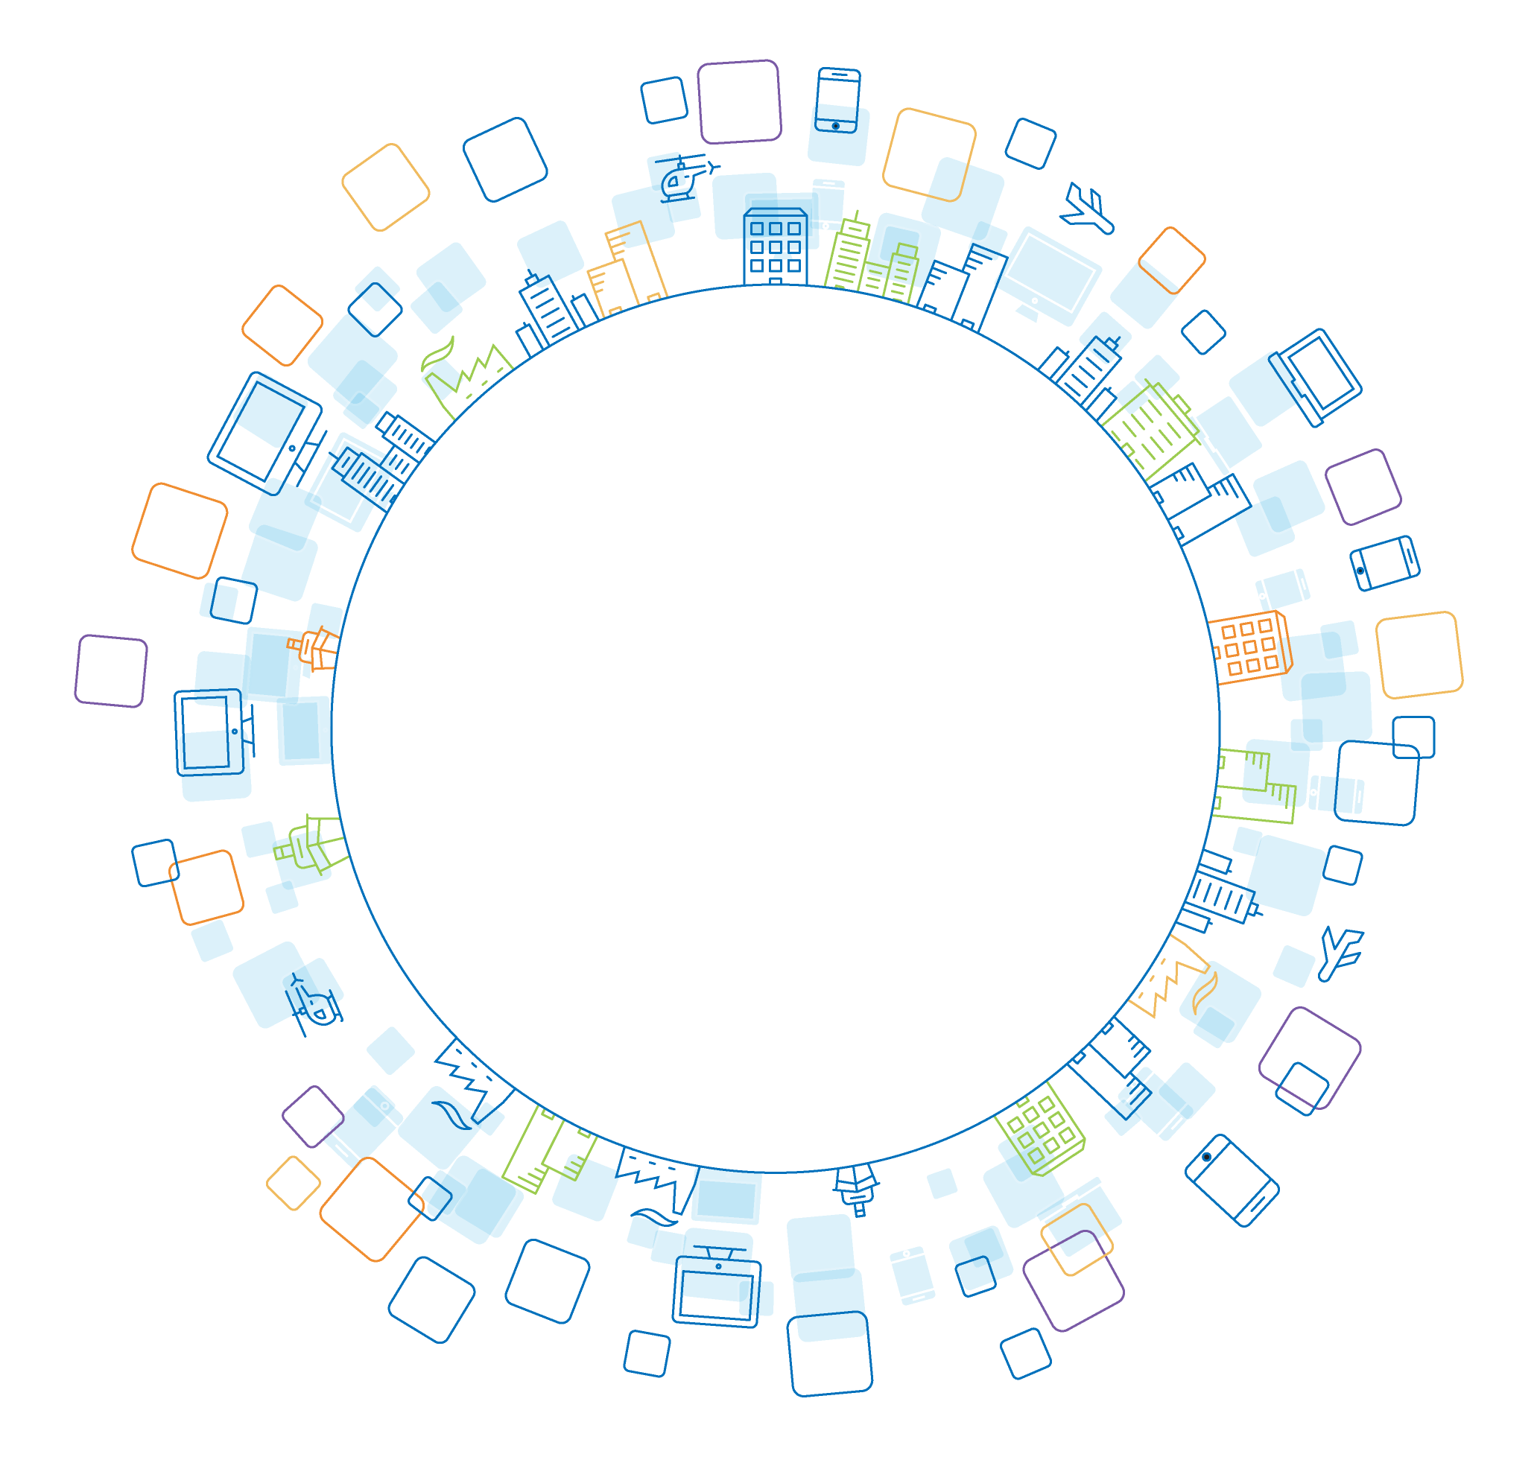
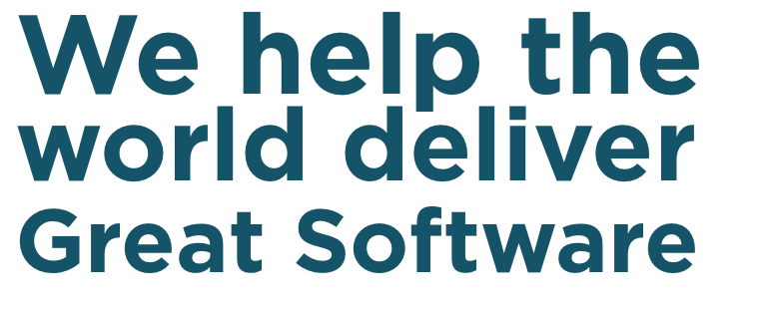
COPY CHANGE “We help the world deliver great software”

Slide 10

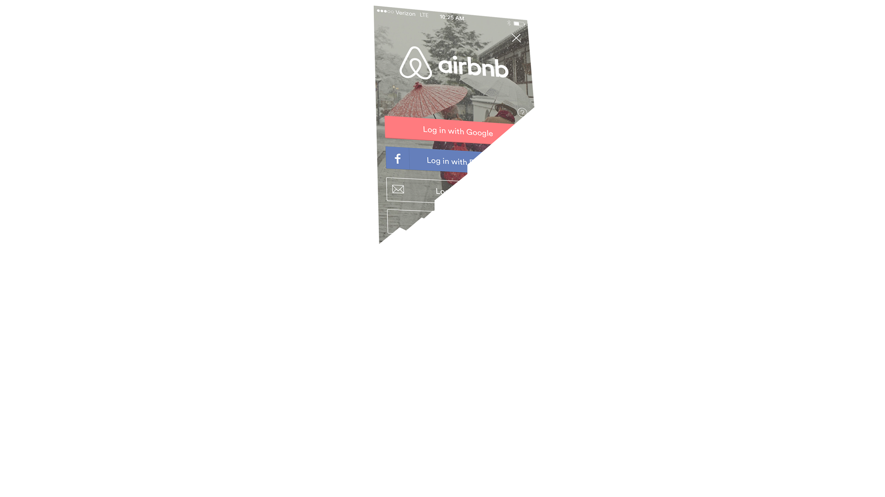

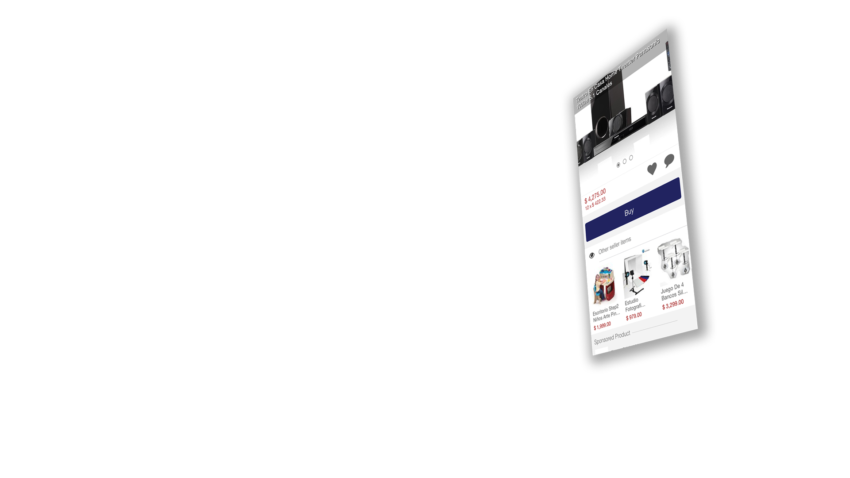

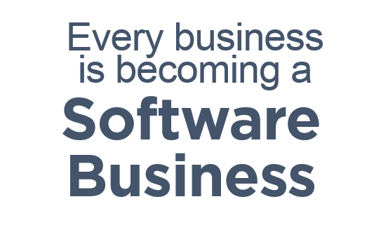
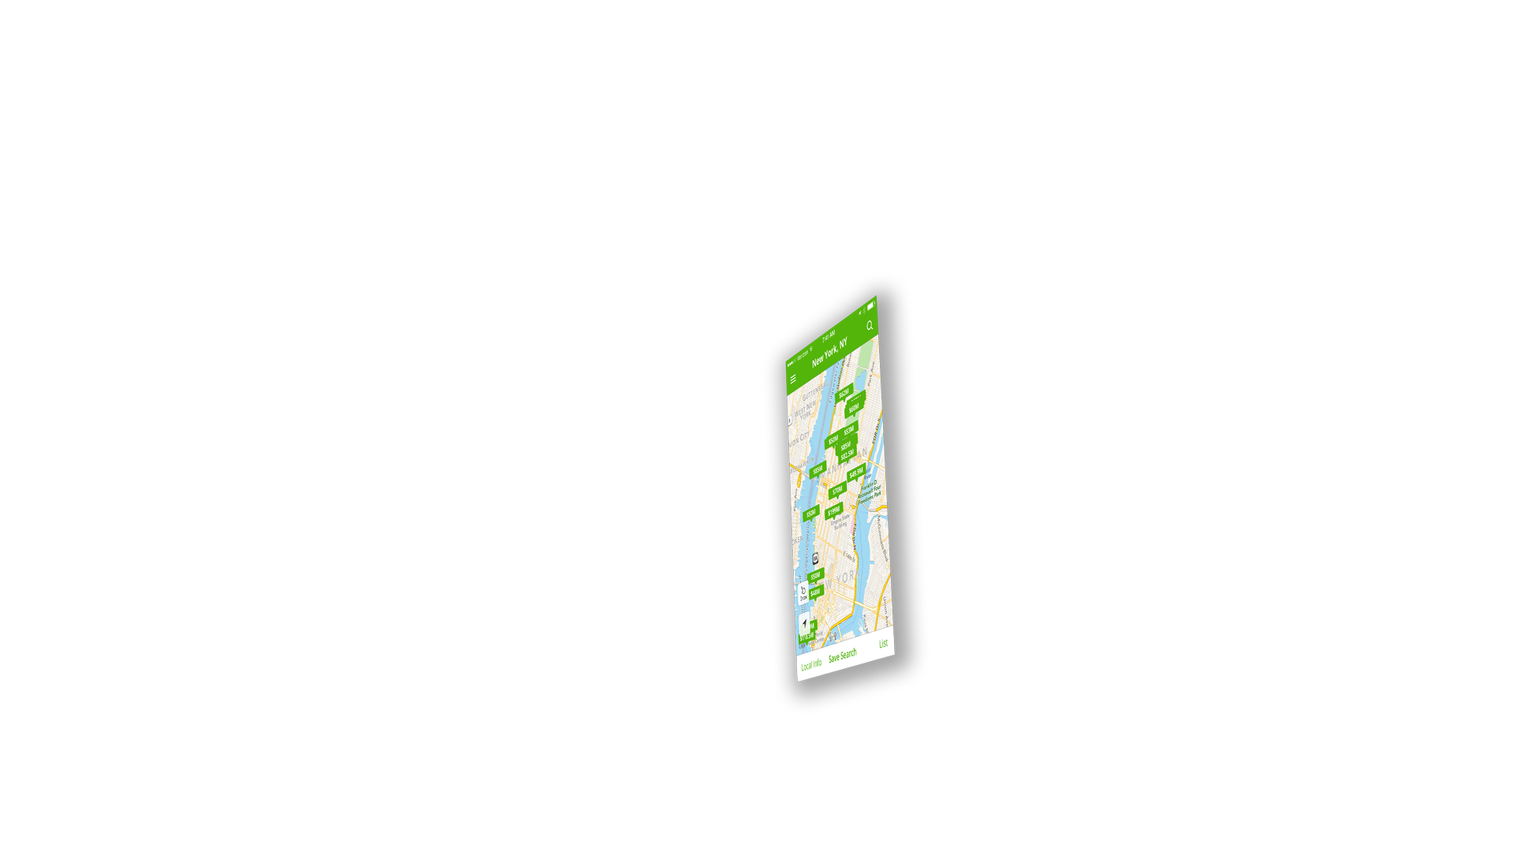

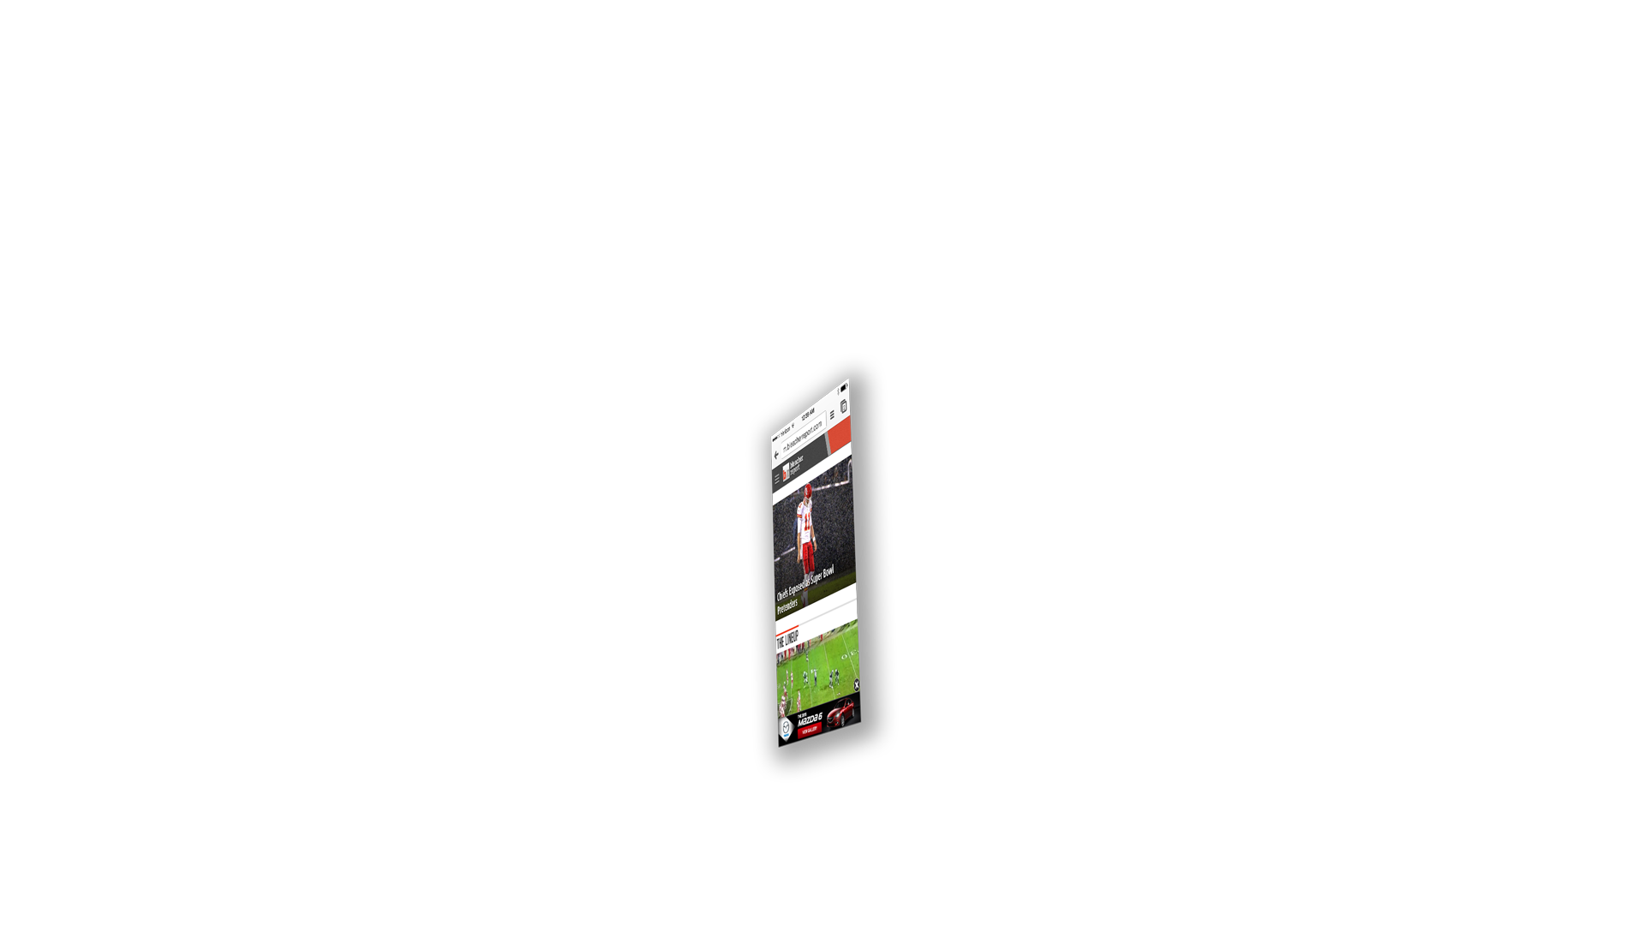





Notes:
TALKING PTS:
And this is rapidly transforming our lives. Software is transforming almost every part of our lives
There’s not a business out there today that’s not transforming how they connect with their customers via software
Because if they are not, they will be disrupted.
Technologies like cloud, mobile have ushered in the next generation of
Platform technologies make building software faster, easier, cheaper than ever before
More and more of our lives will be in front of software
Think of the magic of calling an uber or a lyft. Think of the magic of depositing a check vs going into your bank.
Some of you say no duh
Don’t forget that We’re on the leading edge,

Slide 11

WHAT IS A SOFTWARE BUSINESS?
Notes:
"talk through connection with customer, and how its fundamentally different. Software is not just changing how companies engage with customers, its giving them new opportunities to understand their customer and build a relationship. smart companies today are using sw as a strategic advantage/weapon"

Slide 12
Playing offense with software
Notes:
Transition from back office, automation, cost reduction to increasing the quality of the customer’s experience with its company.
It’s the Disney Magic Band.

Slide 13
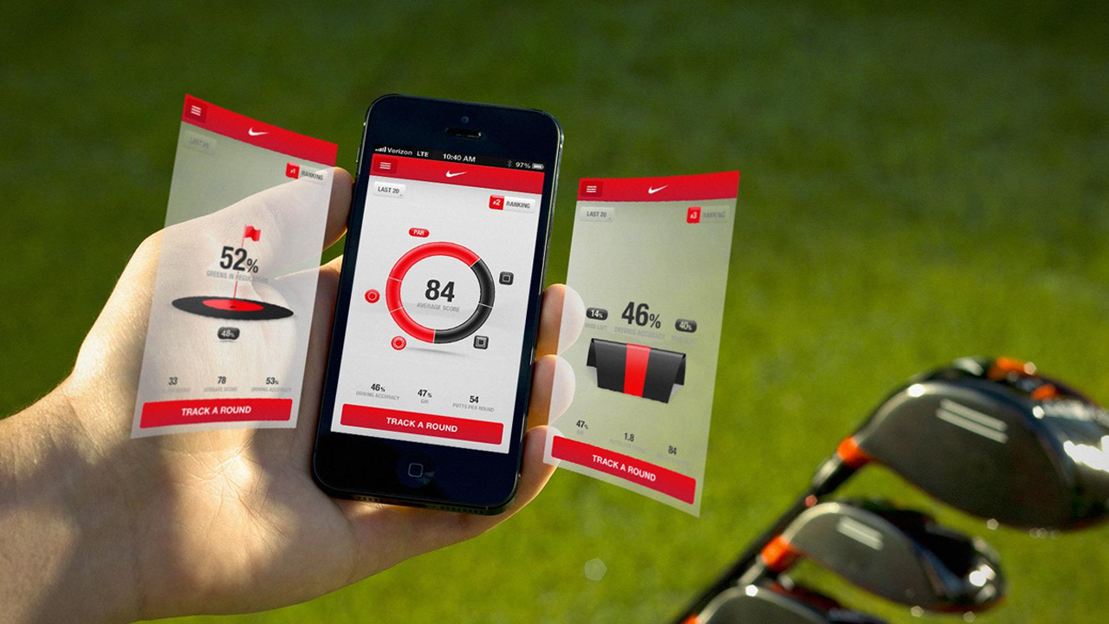

Notes:
Software matters today
Look, we live in an advanced tech community
We are at the beginning of something big
Feeding America example
Nike example – fuel band
UNDER ALL OF THESE EXAMPLES IS SOFTWARE – IMAGE PEEL BACK THE LAYER AND SEE ZEROS AND ONES?
Peel back layer -software runs biz
http://modeadjust.com/wp-content/uploads/2012/02/Nike+FuelBand_01.jpg

Slide 14


Notes:
FEEDING AMERICA:
in the US, 1 in 6 struggles with hunger
Feeding America serves 46.5 million Americans in need
largest domestic hunger-relief organization
provides more than 3.3 billion meals to communities across the United States
More than 12 million children each year

Slide 15
RESULTS MATTER
We are deeply invested in the success of our customers, the company, and each other. We take pride in what we do and hold ourselves to the highest standards.
WHERE ARE WE GOING?

Slide 16
A History of Monitoring
Tomorrow
Today
2000’s
Business
80’s - 90’s
Users
Value
Apps
Server and Networks
Time
Notes:
Category view
If you look at the history of monitoring
In the 80’s and 90’s – there was a $2B market monitoring Infr and servers –
They were monitoring the network, it was a proxy for the apps
Why are they monitoring?
This is the whole point,
This is the nirvana we’re aiming for
User performance, user behavior
Users are customers, drive your business
Software Analytics:
Digital User Analytics
We follow user behavior through mobile, browser

Slide 17
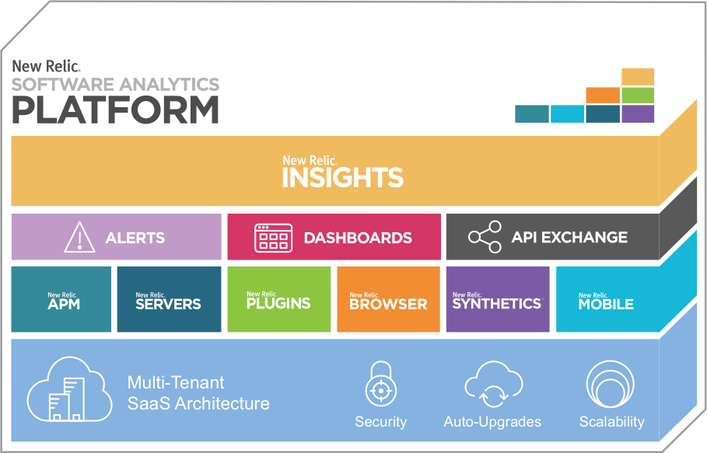
Software Analytics Platform
Business
Business Success
Users
Customer Experience
Apps/Servers
App Performance
Notes:
Category view
If you look at the history of monitoring
In the 80’s and 90’s – there was a $2B market monitoring Infr and servers –
They were monitoring the network, it was a proxy for the apps
Why are they monitoring?
This is the whole point,
This is the nirvana we’re aiming for
User performance, user behavior
Users are customers, drive your business
Software Analytics:
Digital User Analytics
We follow user behavior through mobile, browser

Slide 18

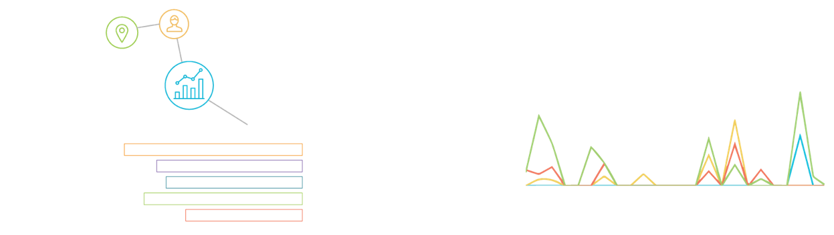
New Relic is THE Software Analytics Platform
that Delivers Moments of Discovery
Notes:
What Software Analytics do:
Unexpected moments of joy
[IMAGE OF SCREEN SHOT OF PRODUCT IN REVERSE, THE POV IS FROM INSIDE THE COMPUTER MONITOR LOOKING OUT AT A CUSTOMER WITH A HUGE SMILE ON THEIR FACE]
Serotonin Rush
We deliver that joy of discovery
Moments that help people do their job, but also create moments of joy
Steve Jobs: Bicycle for the mind….
To do that we must be a platform

Slide 19

New Relic is THE Software Analytics Platform
that Delivers Moments of Discovery
Notes:
What Software Analytics do:
Unexpected moments of joy
[IMAGE OF SCREEN SHOT OF PRODUCT IN REVERSE, THE POV IS FROM INSIDE THE COMPUTER MONITOR LOOKING OUT AT A CUSTOMER WITH A HUGE SMILE ON THEIR FACE]
Serotonin Rush
We deliver that joy of discovery
Moments that help people do their job, but also create moments of joy
Steve Jobs: Bicycle for the mind….
To do that we must be a platform

Slide 20
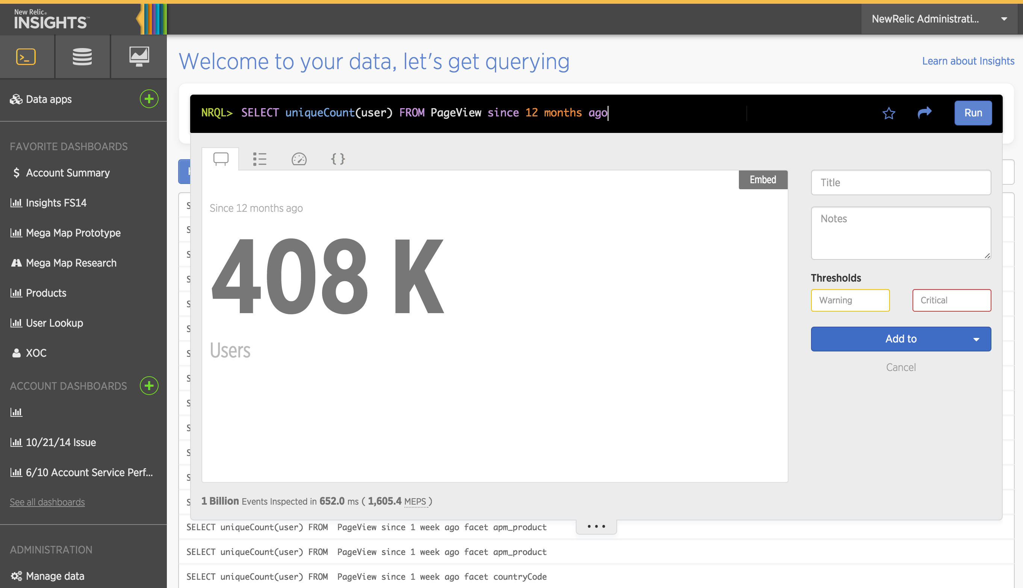
Notes:
Today, we do this for 400k, tomorrow 4M

Slide 21
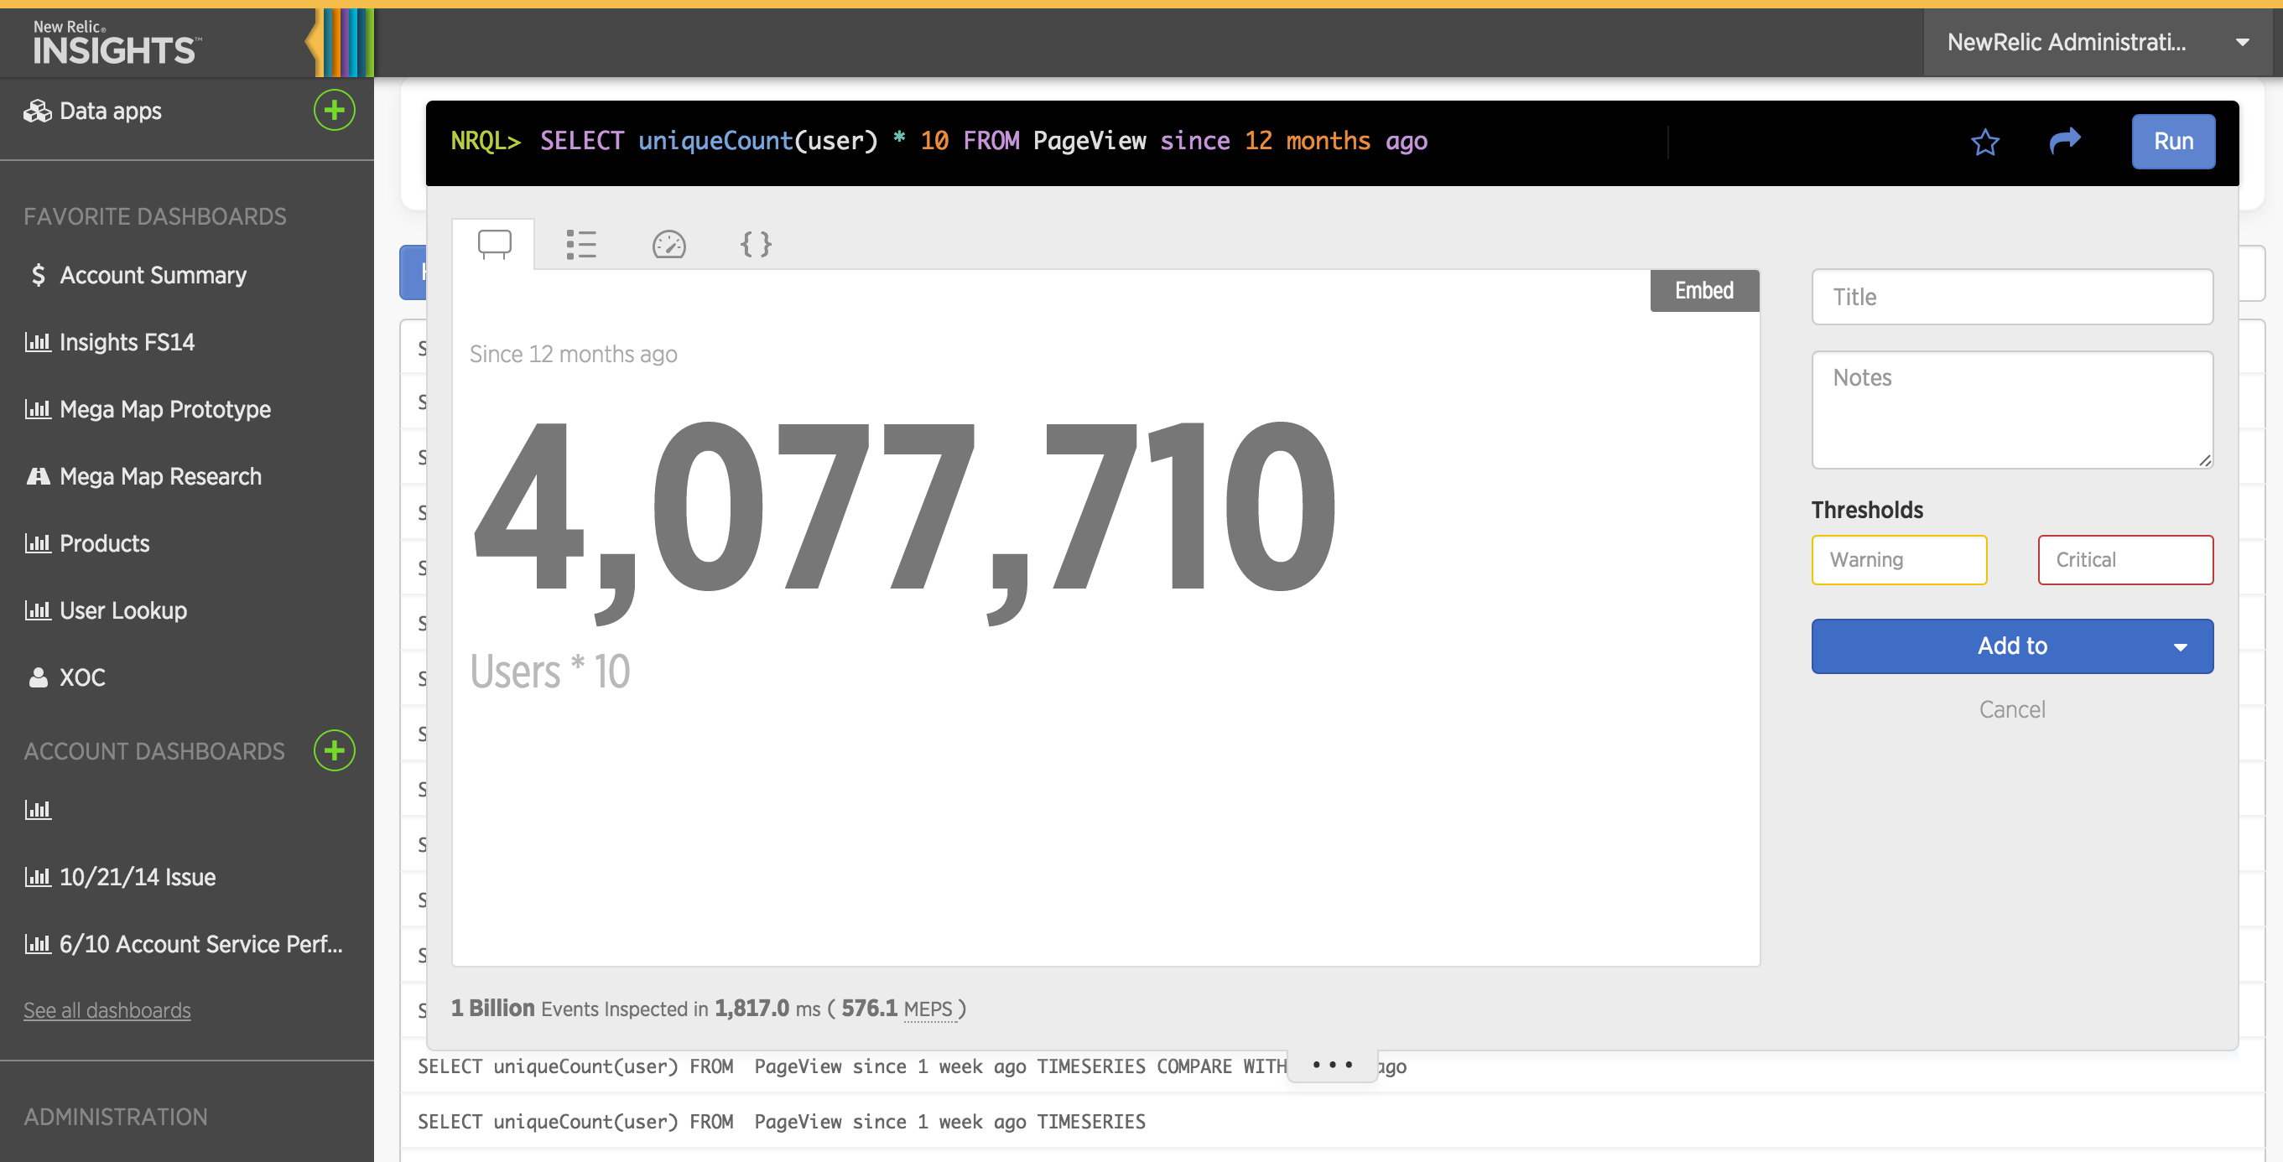
Notes:
Today, we do this for 400k, tomorrow 4M

Slide 22

3 statements -Andrew will send language
Remove interstitial
Clean page with logo bug see thank you slide
WHAT WILL BE TRUE?
WHAT WILL WE MAKE TRUE?
Notes:
We’re going to own our own destiny,
SLIDE: What will we make true?
- Every organization will use data from software to run their business
- Companies will use real-time data to drive top line and bottom line results
- Companies will pick a single SaaS Software Analytics platform
- Knowledge workers will live in our software
- SaaS is the de facto for software analytics, and New Relic will be the market leader
- our brand is synonymous with success

Slide 23
What we will make true
Software Analytics
New Relic
Result
Top 10 Global SaaS company $1B in revenue
Define market
Make essential
Lead shift to SaaS
Own 80% market share
Notes:
The category we have defined, Software analytics, will be globally accepted as 'Must Have' technology for any modern software project, for companies in every vertical in every size. Just as we have created, defined and democratized the multi billion dollar APM market, so we will with Software Analytics

Slide 24
3 statements -Andrew will send language
Remove interstitial
Clean page with logo bug see thank you slide
WE WILL BECOME A PLATFORM COMPANY

Slide 25


World class platform companies
Notes:
Product-first: Obsess over customer experience
Ubiquitous: cult-like following
Value: deliver magic

Slide 26
How we will make it true?
+
+
+
Product First
Architecture
Ubiquity
Value
Integrated Platform
SaaS-delivered Innovation
Intensely Loyal
Top and Bottom Line
Notes:
Four primary levers for bringing our vision to life
We must become a platform company
The way we’ll get there are three things;
1. architecture/SaaS – market is heading this way already, we will win b/c we bet on SaaS
2. Surround the ecosystem – to accelerate saas top down with strategic pships, and bottom up with developer ecosystem
3. Product-first capabilities – shift to platform – not just point solutions.
Value: Sell our value to both top line and bottom line for customers

Slide 27
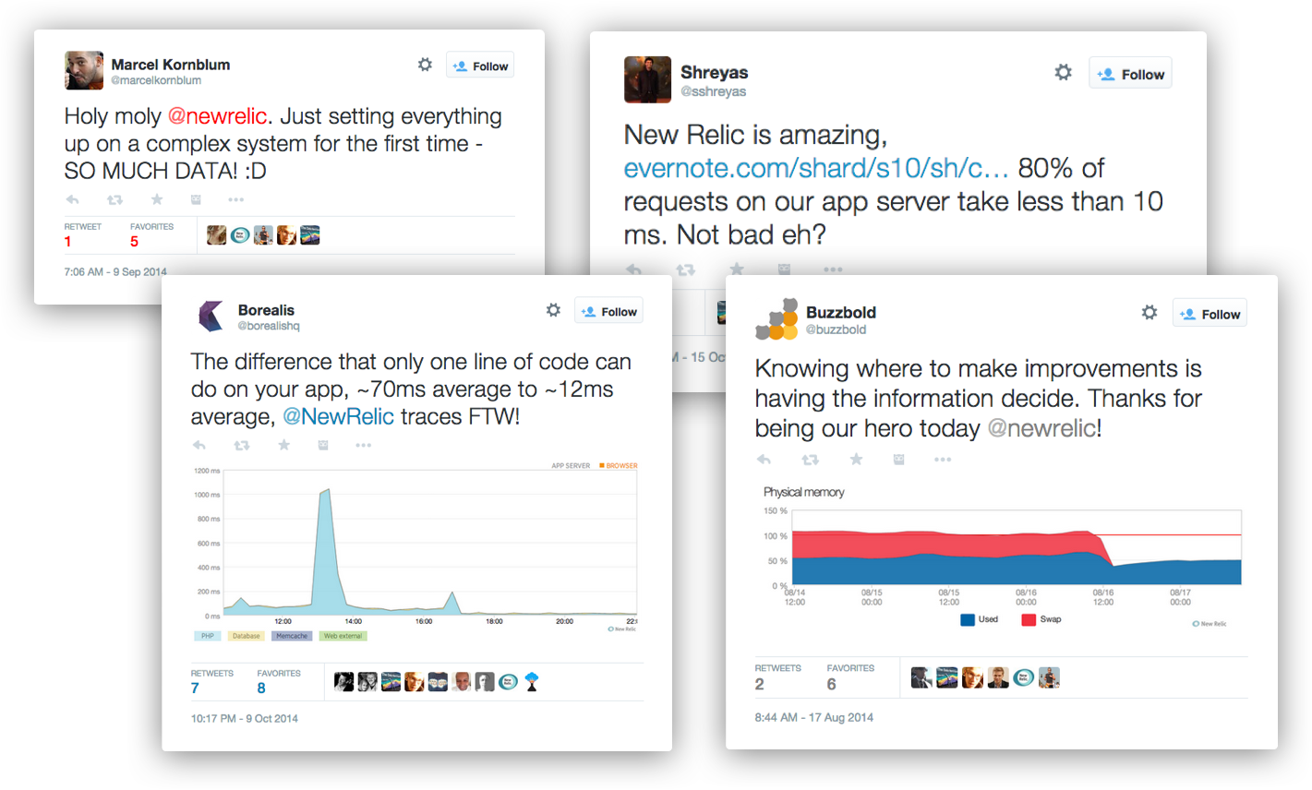
Focusing on Customer Experience

Slide 28
3 statements -Andrew will send language
Remove interstitial
Clean page with logo bug see thank you slide
WHAT WILL WE MAKE TRUE?
Notes:
So, I want to go back to What Will We Make True.
The People in this room will make this happen
I’ve never worked with a more capable team, a team who cares
I’ve never been more excited for our opportunity together.
I want your feedback, please send.

Slide 29


THANK YOU

Slide 30
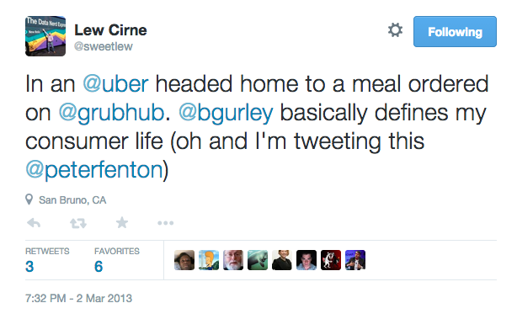
Notes:
Many of you know Benchmark, one of our early investors.
But you may not know one
Bill Gurley BIO:
10 years as a general partner at Benchmark, a Silicon Valley venture capital firm in Menlo Park, California.
- backed consumer brands we all know and love today:
GrubHub, Linden Lab (second life), OpenTable, Uber and Zillow.
- 4 years as analyst on wall street
- design engineer at Compaq Computer, where he worked on products such as the 486/50 and Compaq's first multi-processor server.
- Before Compaq, he served in the technical marketing group of Advanced Micro Devices' embedded processor division.
- blog on the evolution and economics of high technology businesses called Above the Crowd – a must read

Slide 31
Bill Gurley
General Partner, Benchmark
Notes:
Many of you know Benchmark, one of our early investors.
But you may not know one
Bill Gurley BIO:
10 years as a general partner at Benchmark, a Silicon Valley venture capital firm in Menlo Park, California.
- backed consumer brands we all know and love today:
GrubHub, Linden Lab (second life), OpenTable, Uber and Zillow.
- 4 years as analyst on wall street
- design engineer at Compaq Computer, where he worked on products such as the 486/50 and Compaq's first multi-processor server.
- Before Compaq, he served in the technical marketing group of Advanced Micro Devices' embedded processor division.
- blog on the evolution and economics of high technology businesses called Above the Crowd – a must read

